Slide 1

Models Algorisms Accuracy Report
Mohamed Ahmed Mowina

Slide 2

Algorisms
Models Algorisms ware tested in this report:
Random Forest Model
Naive-Bayes Model
SVM Model
Logistic Regression
roBERTa (Pretrained)
RNN Model

Slide 3
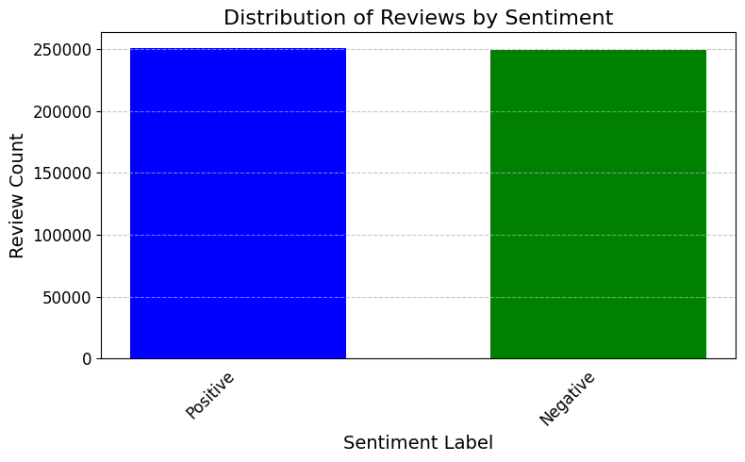
Data Set
The models in this report were trained and tested on a half million rows of Amazon reviews.
80% of the dataset was used in Training and 20% was used in Testing (100K).

Slide 4
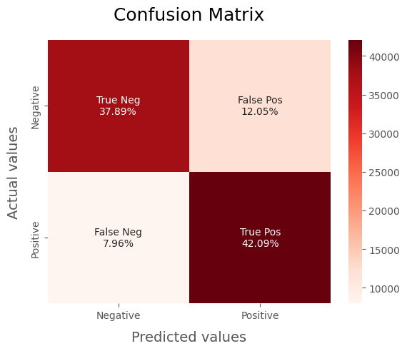
Random Forest Model
This Model had on the testing set accuracy score of 80%.
Took 10 sec to predict 100k sentiment.
On the negative label it scored:
Precision: 0.83
Recall: 0.76
F-1 score: 0.79
On the Positive label it scored:
Precision: 0.78
Recall: 0.84
F-1 score: 0.81

Slide 5
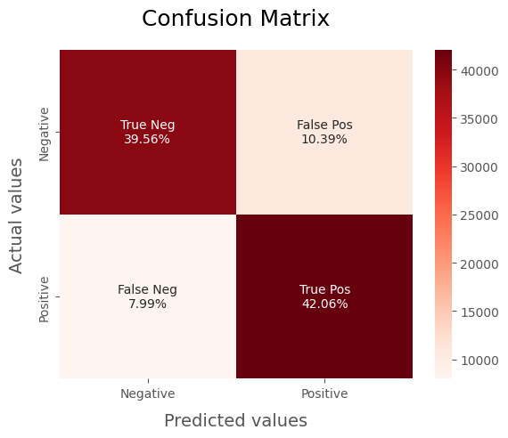
Naive-Bayes Model
This Model had on the testing set accuracy score of 82%.
Took 8 sec to predict 100k sentiment.
On the negative label it scored:
Precision: 0.83
Recall: 0.79
F-1 score: 0.81
On the Positive label it scored:
Precision: 0.80
Recall: 0.84
F-1 score: 0.82

Slide 6
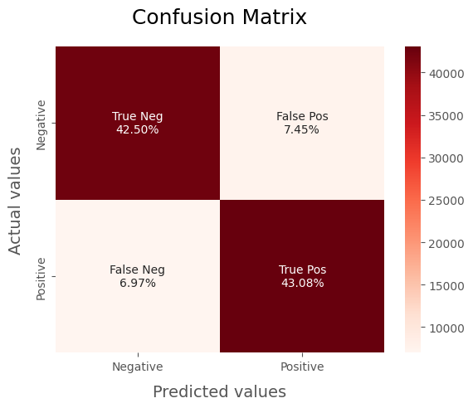
SVM Model
This Model had on the testing set accuracy score of 86%.
Took 6 Hours to predict 100k sentiment.
On the negative label it scored:
Precision: 0.86
Recall: 0.85
F-1 score: 0.85
On the Positive label it scored:
Precision: 0.85
Recall: 0.86
F-1 score: 0.86

Slide 7
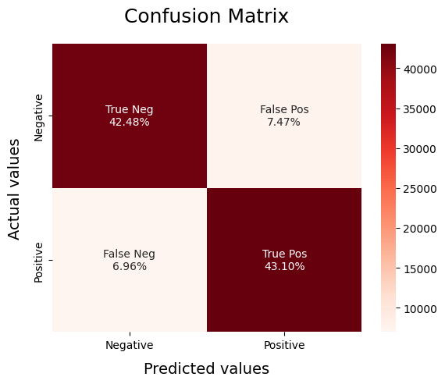
Logistic Regression
This Model had on the testing set accuracy score of 86%.
Took 7.5 sec to predict 100k sentiment
On the negative label it scored:
Precision: 0.86
Recall: 0.85
F-1 score: 0.85
On the Positive label it scored:
Precision: 0.85
Recall: 0.86
F-1 score: 0.86

Slide 8

RoBERTa (Pretrained)
This Model had on the testing set accuracy score of 88.5%.
Took 11 Hours to predict 100k sentiment.
On the negative label it scored:
Precision: 0.92
Recall: 0.84
F-1 score: 0.88
On the Positive label it scored:
Precision: 0.86
Recall: 0.93
F-1 score: 0.89

Slide 9
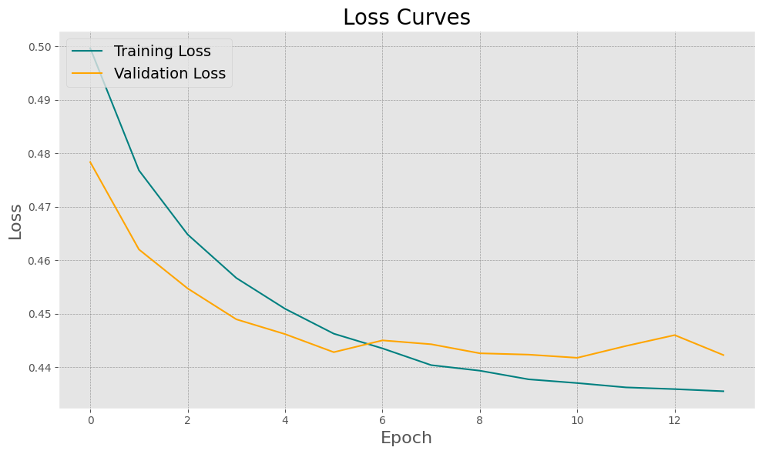
RNN(LSTM) Model
This Model had on the testing set accuracy score of 80%.
To train a Deep learning model with nueral network it’s advised to tokenize the sentences then convert the tokens to numerical number for the model to understand.
this process can interfere with the model accuracy.
In this model we used Tensorflow Keras basic tokenizer but there is better tokenizers for this process.

Slide 10
BERT Tokenizer
Unlocks Context: Analyzes word relationships, crucial for tasks like sentiment analysis and topic modeling.
Handles OOV Words: Gracefully handles unseen words using subword tokenization (wordpieces).
Enhanced Performance: Can lead to significant performance gains compared to basic tokenizers.

Slide 11
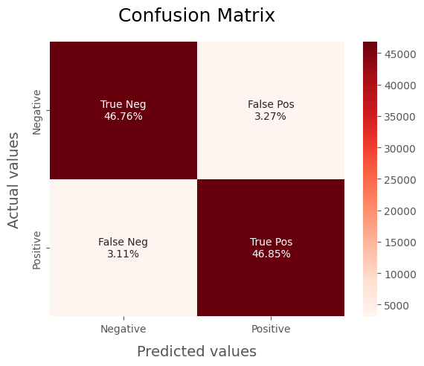
RNN(LSTM) Model with BERT tokenizer
This Model had on the testing set accuracy score of 94%.
Took 2 Hours to predict 100k sentiment.
On the negative label it scored:
Precision: 0.94
Recall: 0.93
F-1 score: 0.94
On the Positive label it scored:
Precision: 0.93
Recall: 0.94
F-1 score: 0.94

Slide 12
Summary
In this report we discovered:
Best models according to only the accuracy is:
RNN model 94%
RoBERTa model 88.5%
Logistic Regression model 86%
SVM Model 86%
Naive-Bayes Model 82%
Random Forest Model 80%
RNN Model have the best accuracy 94% but isn’t the fastest.
Although Logistic Regression model have a lower accuracy but it’s incredible speed can put it into consideration.
Roberta's inference speed might not be ideal for scenarios demanding low latency or high throughput.
Tokenization methods heavily interfere with RNN model accuracy.

Slide 13

Thank You

